Slide 1
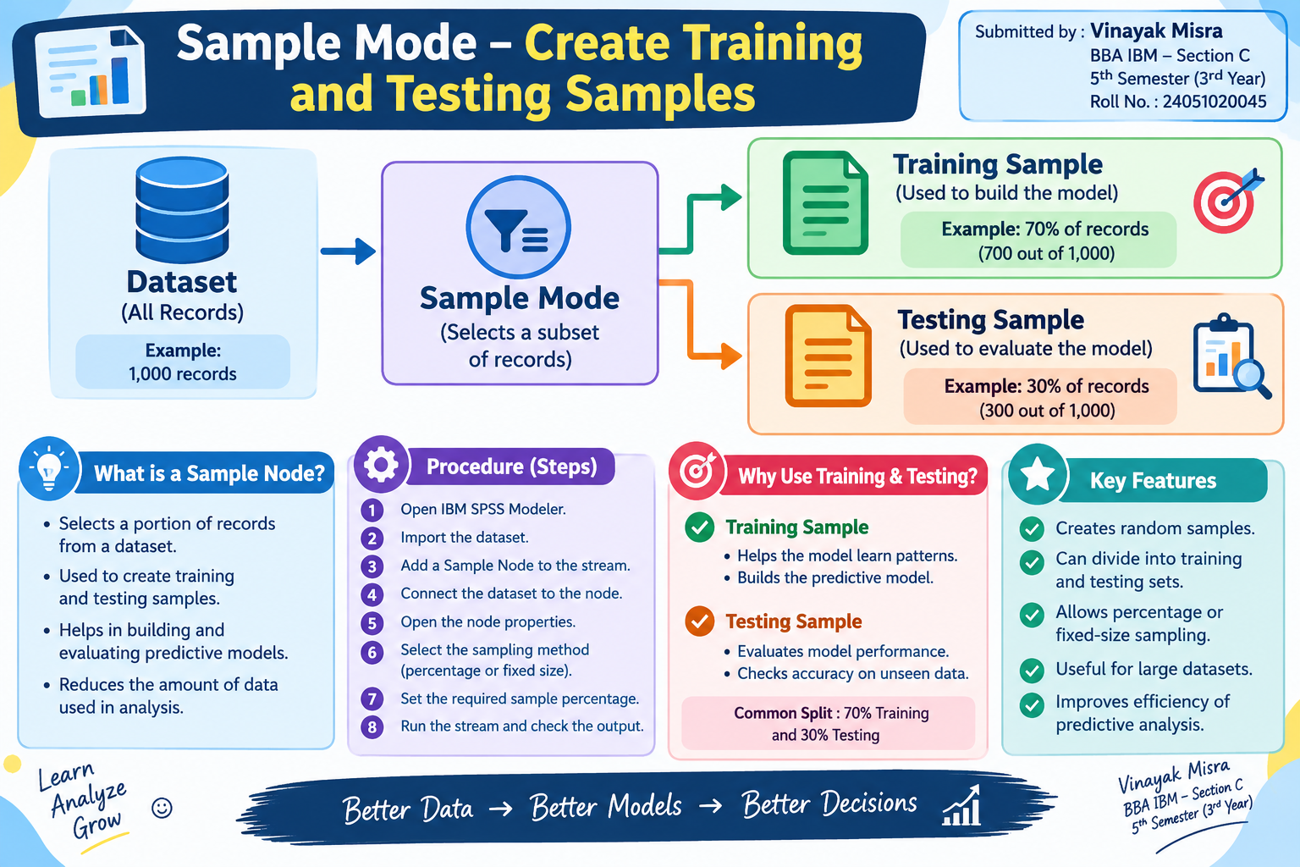

Slide 2
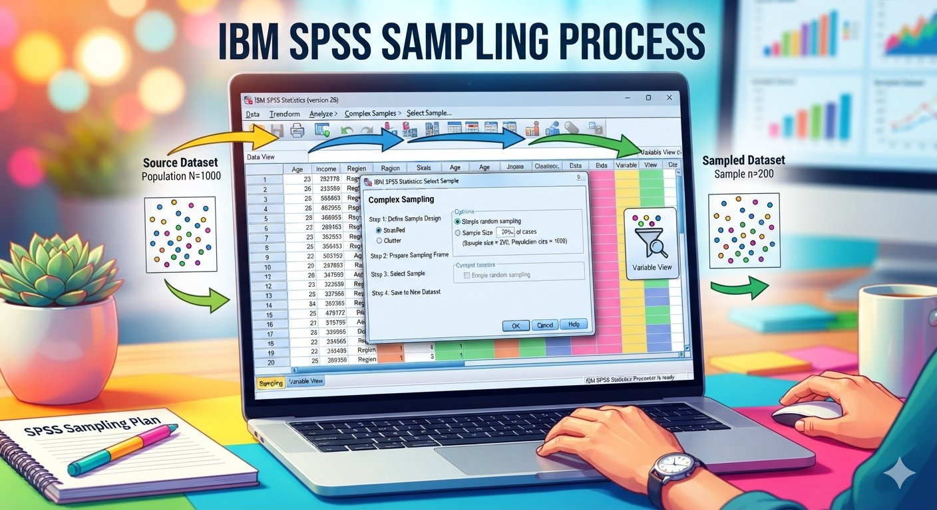
Introduction
Sample Mode in IBM SPSS Modeler is used to select a subset of records from a large dataset.
It helps divide data into training and testing samples for predictive analysis.
The training sample is used to build the model, while the testing sample is used to evaluate its performance.
Example:
📊 1,000 records → 700 Training records + 300 Testing records
👉 In simple words: Sampling Mode helps select a suitable part of the data for building and testing a model.

Slide 3
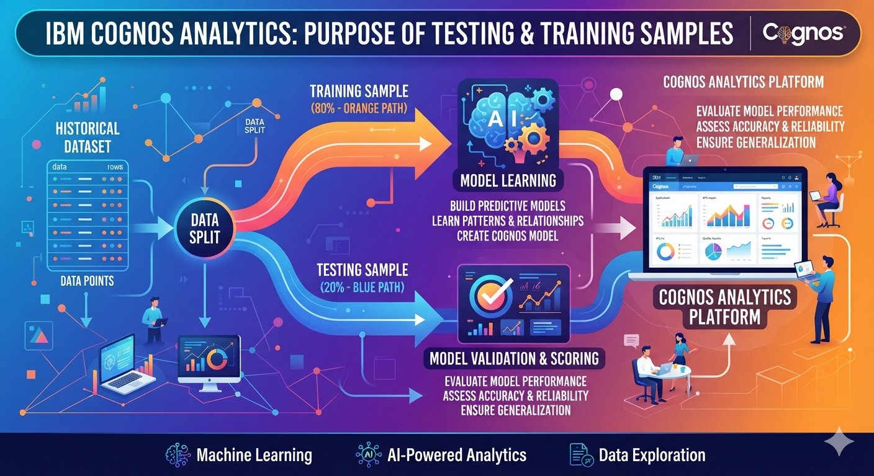
Purpose of Training and Testing Samples
Purpose of training samples –
It is used to train or build the model.
The model learns patterns and relationships from the training data.
It usually contains a larger portion of the dataset.
Purpose of testing samples -
It is used to evaluate the accuracy of the model
It is used to identify errors or incomplete predictions in data.
.It is used to determine whether the model can generalize beyond the training data.

Slide 4
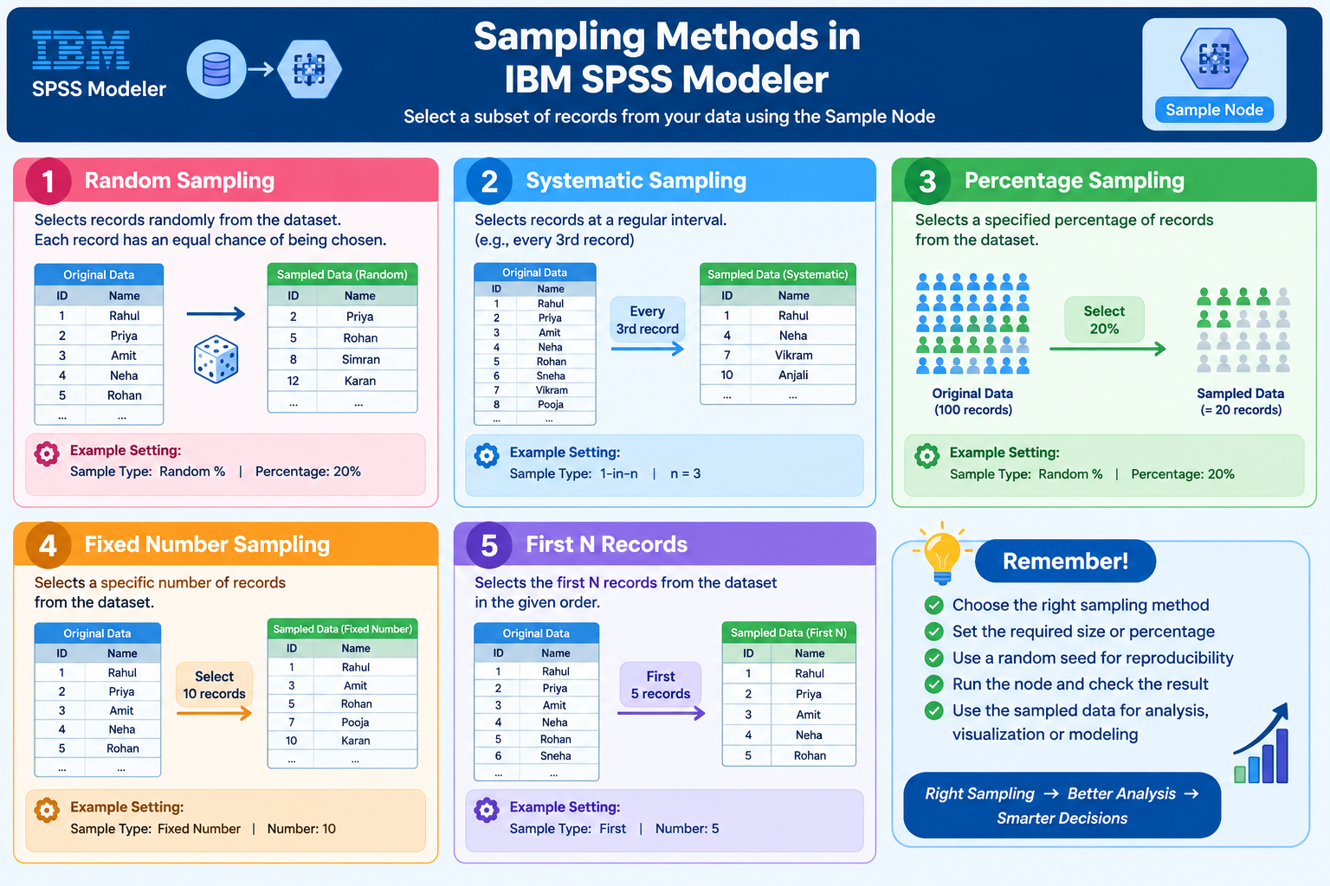
Types of sampling method in ibm spss modeller
Random sampling
Systematic Sampling
Percentage Sampling
Fixed Number sampling
First N Records

Slide 5
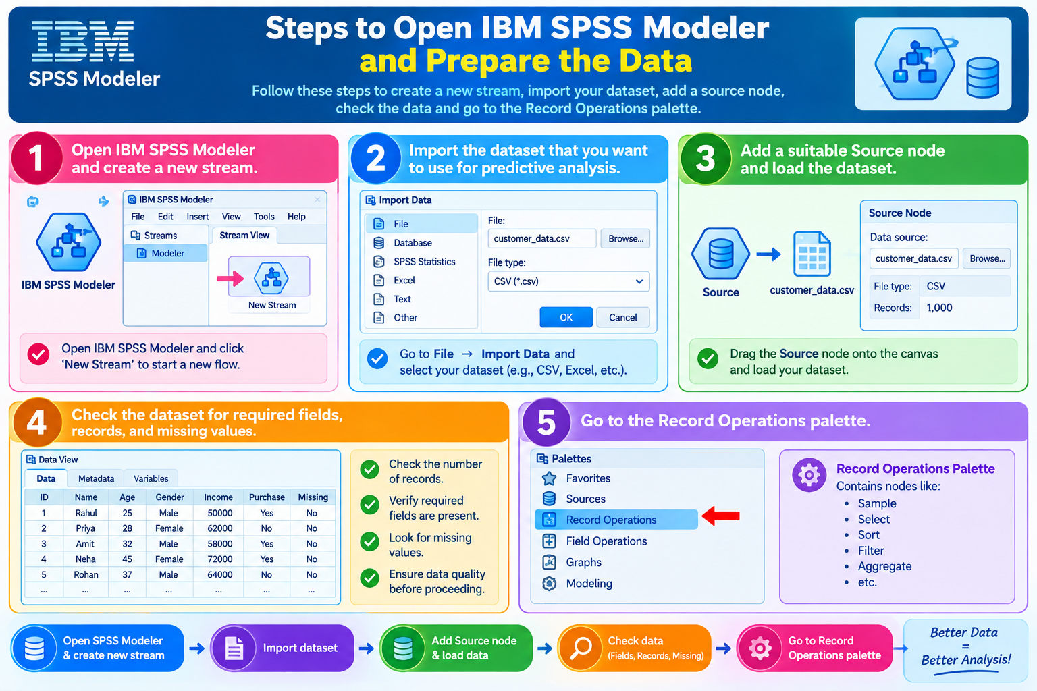
Creating Samples in IBM SPSS Modeler
Open IBM SPSS Modeler and create a new stream.
Import the dataset that you want to use for predictive analysis.
Add a suitable Source node and load the dataset.
Check the dataset for required fields, records, and missing values.
Go to the Record Operations palette.

Slide 6
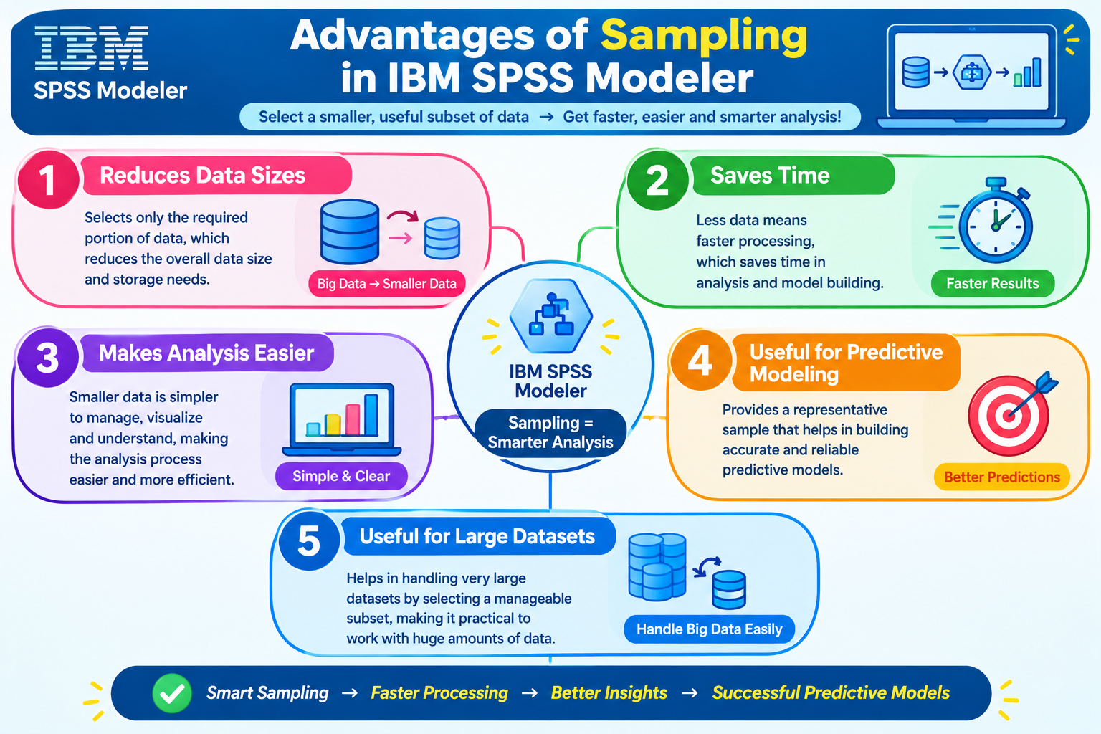
Advantages of Sampling in IBM SPSS Modeler
Reduces data sizes
Saves Time
Makes Analysis easier
Useful for Predictive Modeling
Useful for large dataset .

Slide 7
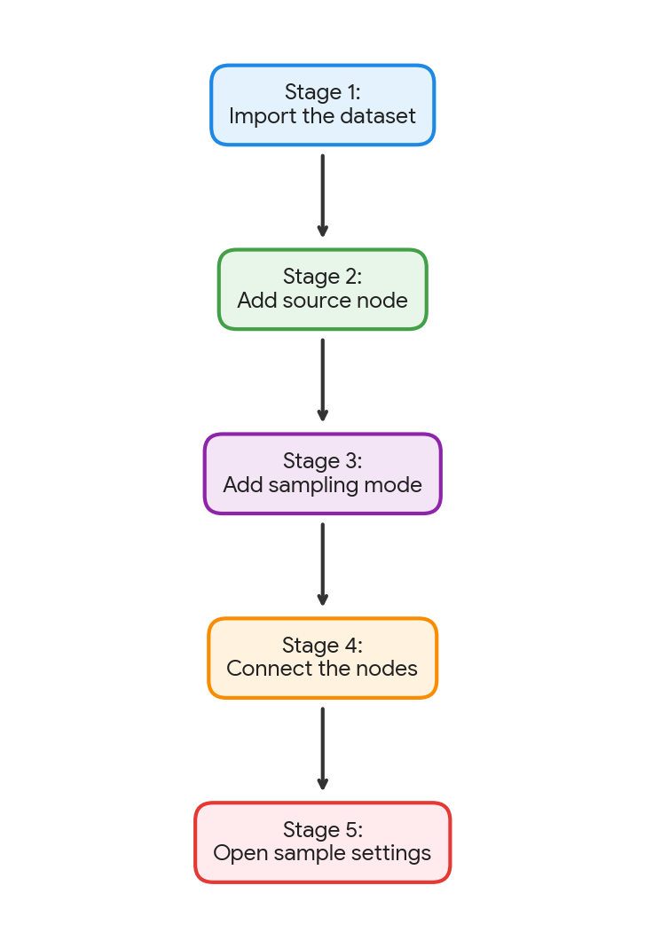
Sample Creation Process
Import the dataset
Add source node
Add sampling mode
Connect the nodes
Open sample settings

Slide 8
Conclusion
The Sample Node in IBM SPSS Modeler helps select a suitable subset of records from a large dataset.
It reduces the size of data, saves processing time and computer resources, and makes data analysis easier.
Different sampling methods can be used according to the requirement. The selected sample can be used for data exploration, model development, testing, and predictive analysis.
Overall, sampling makes the data analysis process faster, simpler, and more efficient.

